Slide 1
Network Automation
Network monitoring and auto incident MONITORING tool

Slide 2
We created one application that will perform as below task in network automation concept:-
01:- All WAN Link Utilization Real-time dashboard on Single page.
02:- Network Monitoring Automation Tool that Monitor Node’s IP and Generate Incident in with date time.

Slide 3
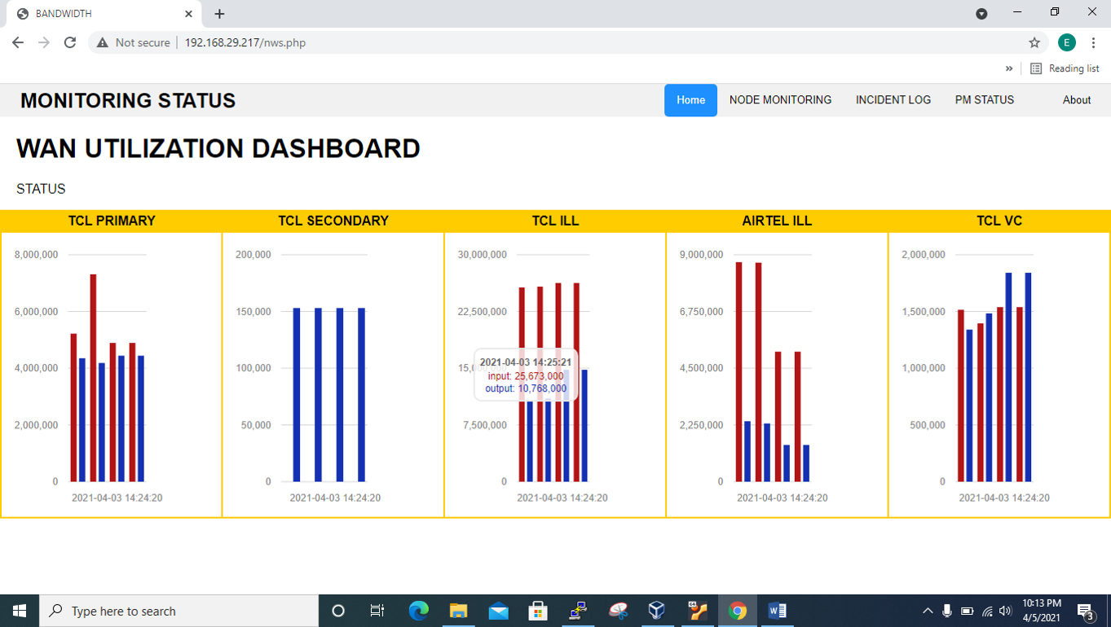
01:- All WAN Link Utilization Real-time dashboard on Single page.
All WAN link Utilization showing on single page that can easy to understand where needs to be hit.

Slide 4
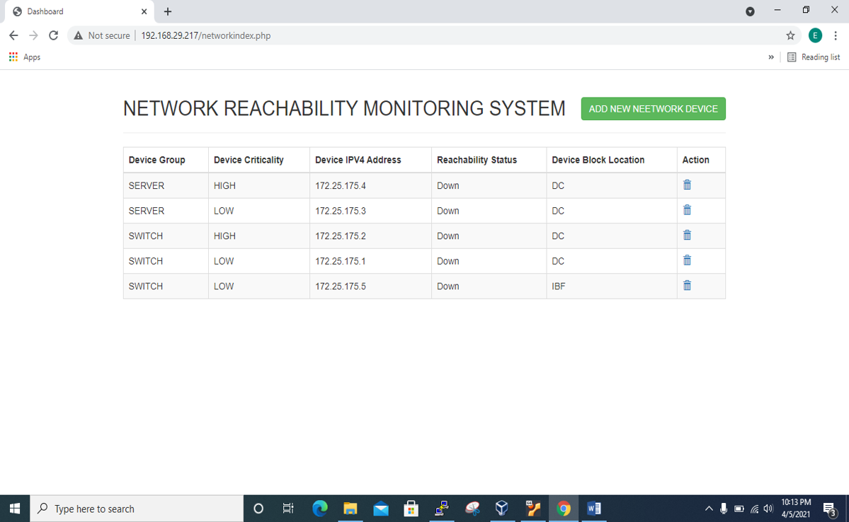
02:- Network Monitoring Tool Automation that Monitor Node’s IP and Generate Incident in with date time.
Network Monitoring Module check IP Address reachability
AND IF devices will Un-reachable application will generate
Auto-Incident in Application Page.

Slide 5
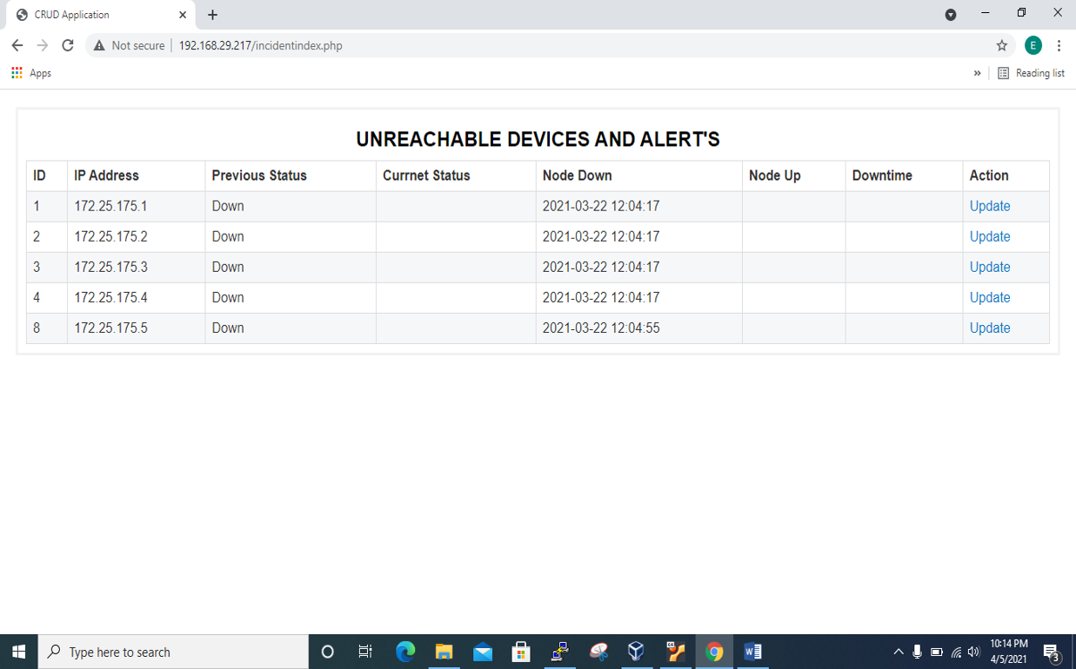
02:- Network Monitoring Tool Automation that Monitor Node’s IP and Generate Incident in with date time.
Application will track Incident Information in this page and provide console to user to close the Incident Number after once Node IP Address Reachable.

Slide 6
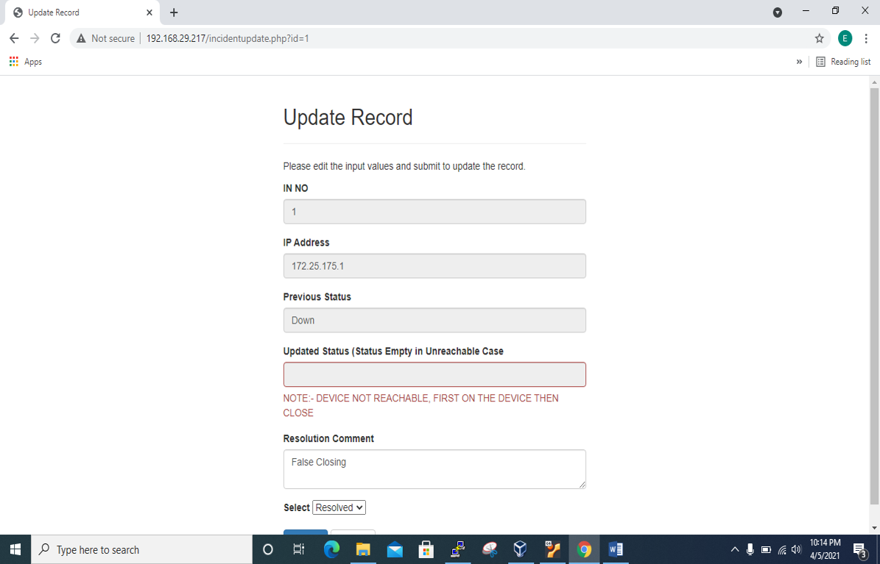
02:- Network Monitoring Tool Automation that Monitor Node’s IP and Generate Incident in with date time.
Application Stop Incident Close Process
IF
Device Unreachable.
AND
Provide OUTPUT
“DEVICE NOT REACHABLE”

Slide 7
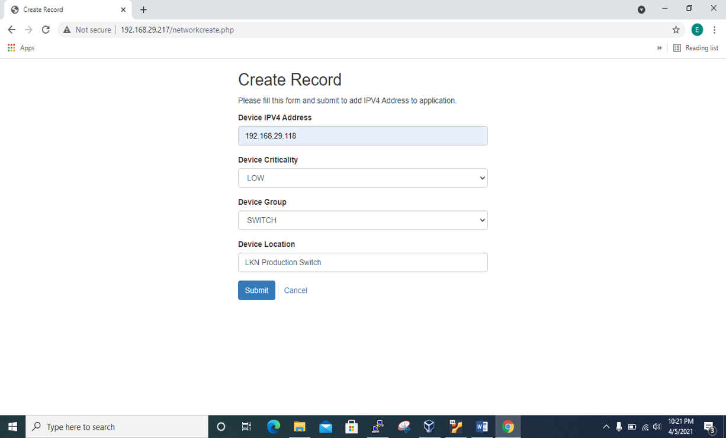
02:- Network Monitoring Tool Automation that Monitor Node’s IP and Generate Incident in with date time.
Application Provide Console to Addition Node IP Address in Application with Device Criticality and Device Group.
AND Result Provide as CRITICALITY AND GROUPS.

Slide 8
Network Automation
THIS IS A SIMPLE EXAMPLE OF AUTOMATION.
WORKING ON:-
01:- Automation backup OF SWITCHES on one click.
And more.

Slide 9
Thank You
SHAMSHER SINGH

